Slide 1
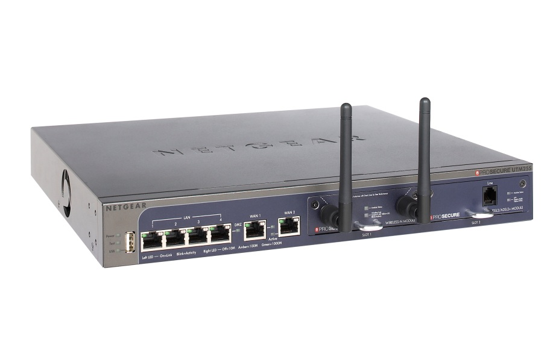
UTM S Series OVERVIEW
November, 2012

Slide 2
UTM S Series - What it is
A modular all-in-one next-generation firewall

Slide 3
Features - Security
Application Firewall
Anti-virus
Anti-spam
Web Filtering
IPS
SPI Firewall
IPSec & SSL VPN
Monitor and control up hundreds of applications like Skype and Facebook
Sophos engine and library with over 1 million virus signatures
Hybrid in-the-cloud real-time spam detection
Dynamic cloud-based database with 64 categories
Block hackers and other network attacks
Secure client-to-site & site-to-site secure remote access
Traditional stateful packet inspection with bandwidth control and QoS

Slide 4
Features - Connectivity
2 built-in slots for Wireless and ADSL/VDSL modules
Wireless-N
USB 3G dongle support from qualified ISPs
ADSL2+/VDSL Annex B
ADSL2+/VDSL Annex A
802.1q VLAN support
4 Gigabit LAN ports, 2 Gigabit WAN ports
Over 15 dongles supported worldwide
Dual WAN Failover and load balancing

Slide 5
Features - Simplicity
Intuitive Web-based GUI
No per-user licensing
Setup and VPN Wizards
No need to purchase additional “seats” as the network grows
Easy to use, no training necessary
Help simplify installation

Slide 6
Benefits – Security Compared
The traditional firewall provides no visibility or protection from layer 7 applications and threats.
This approach was ok in 2002 when most applications had their own servers and dedicated ports.
Here in 2012 most applications are hosted in the cloud and application traffic is tunneled through port 80 and 443 – ports that are typically configured as ALLOW on most firewalls.

Slide 7
Benefits – Security Compared
The UTM Firewall is able to look beyond ports and IP addresses and actually inspect layer 7 payload.
It can identify and monitor layer 7 applications such as Skype and Facebook and stop layer 7 threats such as viruses and spam.
This gives control of the network back to the IT admin!

Slide 8
Benefits – Security Compared
UTM Firewall
Stateful Packet Inspection
VPN
IPS
Application Control
Anti-virus
Anti-spam
Web filtering
Traditional Firewall
Stateful Packet Inspection
VPN
IPS *maybe*
no
no
no
no

Slide 9
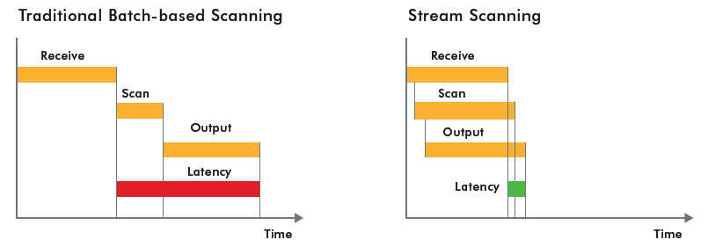
Benefits – Patented Stream Scanning
NETGEAR patented technology
Allows for high performance, low latency scanning

Slide 10
Benefits – Best in Class Anti-virus
Zoo Malware Detection Result Comparison Using HTTP, POP3 and SMTP Protocols
WildList Malware Detection Rate of HTTP
As reported by AV-Test, GmbH
As reported by AV-Test, GmbH
100%
100%
100%
90%
HTTP
POP3
SMTP
75%
81%
81%
75%
75%
70%
63%
50%
50%
49%
29%
35%
25%
32%
25%
21%
19%
0%
0%
NETGEAR ProSecure UTM10
Fortinet FortiGate -608
SonicWALL TZ 100
SonicWALL TZ 210
WatchGuard Firebox Edge X55e
NETGEAR ProSecure UTM10
Fortinet FortiGate -608
SonicWALL TZ 100
SonicWALL TZ 210
WatchGuard Firebox Edge X55e

Slide 11
Models – UTM25S
NEW!
For networks with up to 25 users
2 module slots
4 Gigabit LAN ports
2 Gigabit WAN ports
980 Mbps Firewall throughput
40000 concurrent connections
240 Mbps IPS throughput ←Significant improvement!
30Mbps Anti-virus throughput
24~240Mbps UTM throughput (depends on the type of traffic)

Slide 12
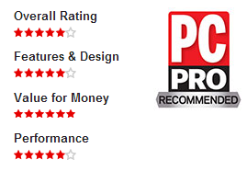
Models – UTM9S
For networks with up to 10 users
2 module slots
4 Gigabit LAN ports
2 Gigabit WAN ports
933 Mbps Firewall throughput
16000 concurrent connections
172 Mbps IPS throughput ←Significant improvement!
23Mbps Anti-virus throughput
23~172Mbps UTM throughput (depends on the type of traffic)

Slide 13
Modules

Slide 14
SKUs - Hardware
Firewall Only
UTMxS-100NAS
UTMxS-100EUS
1 Year Bundle (Firewall + 1 year subscription)
UTMxSEW-100NAS
UTMxSEW-100EUS
3 Year Bundle (Firewall + 3 year subscription)
UTMxS-100AJS
UTMxSEW-100AJS
UTMxSEW3-100NAS
UTMxSEW3-100EUS
UTMxSEW3-100AJS
Modules
1 Year Module Bundles
UTMxEWWN-100NAS/EUS/AJS (Wireless-N)
UTMxEWDA-100NAS/EUS/AJS (VDSL/ADSL2+ Annex A)
UTMxEWDB-100EUS (VDSL/ADSL2+ Annex B)
NMWLSN-10000S Wireless-N module
NMVDSLA-10000S VDSL/ADSL2+ module (Annex A)
NMVDSLB-10000S VDSL/ADSL2+ module (Annex B)

Slide 15
SKUs - Licenses
1 Year Subscriptions
UTMxSW-10000S Web Threat Management
3 Year Subscriptions
UTMxSE-10000S Email Threat Management
UTMxSB-10000S Subscription Bundle (Web + Email + Support & Maintenance)
UTMxSM-10000S Software Maintenance and Upgrades 24/7 Support, Advanced Replacement
UTMxSB3-10000S Subscription Bundle (Web + Email + Support & Maintenance)
UTMxSW3-10000S Web Threat Management
UTMxSE3-10000S Email Threat Management
UTMxSM3-10000S Software Maintenance and Upgrades 24/7 Support, Advanced Replacement

Slide 16
Pricing- UTM25S
 | SKU | Description | List Price (NA)
Hardware/ Bundles | UTM25S-100NAS | UTM25S - Hardware only | 690
 | UTM25SEW-100NAS | UTM25S HW SUBS BUNDLE 1YR | 1,008
 | UTM25SEW3-100NAS | UTM25S HW SUBS BUNDLE 3YR | 1,705
 | UTM25EWDA-100NAS | UTM25S VDSL-A BUNDLE 1YR | 1,008
 | UTM25EWWN-100NAS | UTM25S WLS N BUNDLE 1YR | 1,008
Licenses | UTM25SB-10000S | UTM25S ALL SUBS 1YR | 450
 | UTM25SB3-10000S | UTM25S ALL SUBS 3YR | 1,145
 | UTM25SE-10000S | UTM25S EMAIL SUB 1YR | 173
 | UTM25SE3-10000S | UTM25S EMAIL SUB 3YR | 440
 | UTM25SM-10000S | UTM25S MAINT SUB 1YR | 104
 | UTM25SM3-10000S | UTM25S MAINT SUB 3YR | 264
 | UTM25SW-10000S | UTM25S WEB SUB 3YR | 173
 | UTM25SW3-10000S | UTM25S WEB SUB 3YR | 440

Slide 17
Pricing- UTM9S
 | SKU | Description | List Price (NA)
Hardware/ Bundles | UTM9S-100NAS | UTM9 – Hardware only | $ 520
 | UTM9SEW-100NAS | UTM9S HW SUBS BUNDLE 1YR | $ 759
 | UTM9SEW3-100NAS | UTM9S HW SUBS BUNDLE 3YR | $ 1,283
 | UTM9EWDA-100NAS | UTM9S VDSL-A BUNDLE 1YR | $ 759
 | UTM9EWW-100NAS | UTM9S WLS N BUNDLE 1YR | $ 759
Licenses | UTM9SB-10000S | UTM9S - ALL SUBS 1YR | $ 338
 | UTM9SB3-10000S | UTM9S - ALL SUBS 3YR | $ 862
 | UTM9SE-10000S | UTM9S EMAIL SUB 1YR | $ 130
 | UTM9SE3-10000S | UTM9S EMAIL SUB 3YR | $ 331
 | UTM9SM-10000S | UTM9S MAINT SUB 1YR | $ 78
 | UTM9SM3-10000S | UTM9S MAINT SUB 3YR | $ 199
 | UTM9SW-10000S | UTM9S WEB SUB 1YR | $ 130
 | UTM9SW3-10000S | UTM9S WEB SUB 3YR | $ 331

Slide 18
Use Cases
Primary Firewall For:
Small Businesses
Remote Office
Branch Office
SOHO

Slide 19
Typical Deployment

Slide 20
Customers to Target
Businesses running NETGEAR ProSafe firewall or NETGEAR home routers
Businesses with 25 users or less looking for an all-in-one solution that includes wireless or ADSL/VDSL
Businesses needing control over employee application use
Businesses recently struck by malware

Slide 21
Qualifying Questions
Words to Listen For: Firewall, VPN, Remote Workers/Facilities, Security, SPAM, E-Mail, Web, Network LAN, Application control/monitoring
Are you concerned about what your employees are doing at their desks? Are they surfing the web aimlessly and spending too much time on facebook, google or twitter? Are you able to monitor this activity effectively and ensure you’re getting the productivity you pay for?
When was the last time your organization had a virus/malware/scareware event? Are you concerned about threats of this type and the potential for down time or costly repairs?
How many different kinds of computing devices do you have? (Desktop systems, Android device or iphone/ipad?) Are you running antivirus on all of these?

Slide 22
Customers to Avoid
Existing SonicWALL, Fortinet, and Watchguard customers who still have more than half a year on their subscriptions – Not easily converted
Customers with over 200 users – Exceeds current UTM capacity
Customers who are not looking to replace their firewall

Slide 23
Good Things to Know
All UTM bundles now come with a digital license. This means there is no longer a piece of paper with the license key that comes in the box. All UTMs bundles are now pre-registered at factory. Simply connect the UTM to the Internet, login to the GUI, and register.
The UTM now has NMS200 support. You can monitor multiple UTMs from NETGEAR NMS200 software.
ReadyNAS Integration – The UTM can integrate with an x86 based ReadyNAS for expanded logging and quarantine capabilities.

